Slide 1
Reinforcement Learning

Slide 2
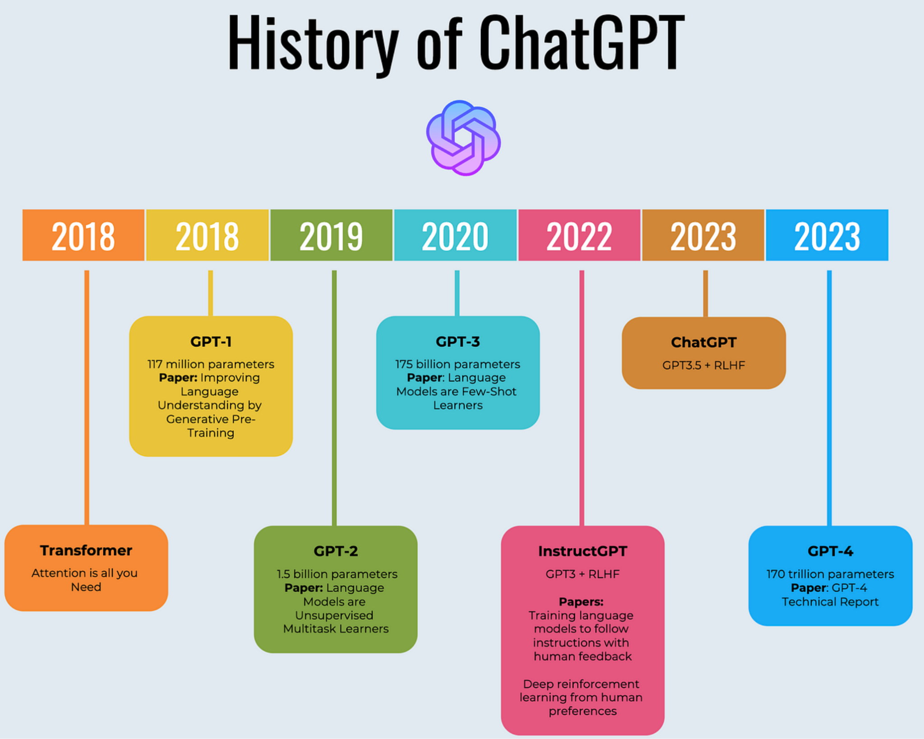

Slide 3
Problem statement
Some problems have an objective, correct answer:
Classification (dog vs cat)
Other problems tasks don’t have one clear, best answer:
Generating a summary (it much depends on preferences)

Slide 4
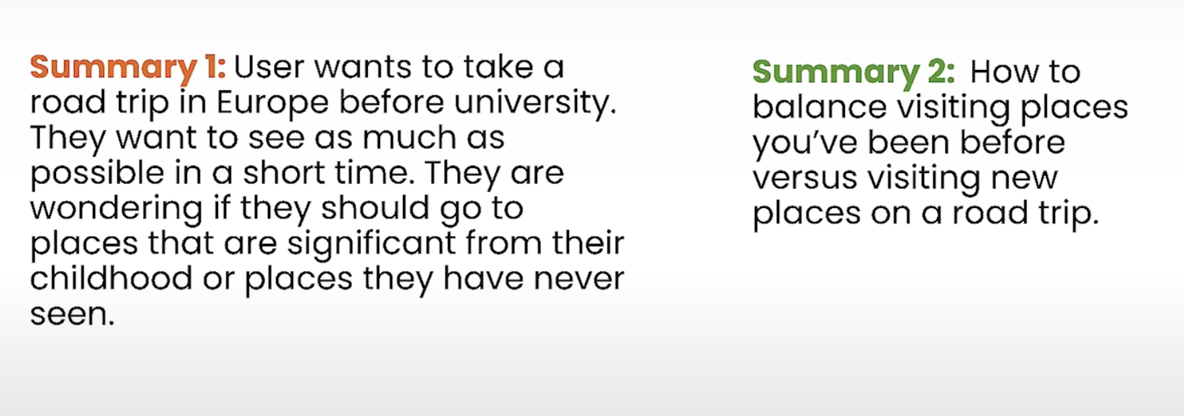

Slide 5
Problem statement
Preferences are hard to quantify
So what can we do?
We frame the problem differently
RLHF (Reinforcement Learning with Human Feedback)

Slide 6
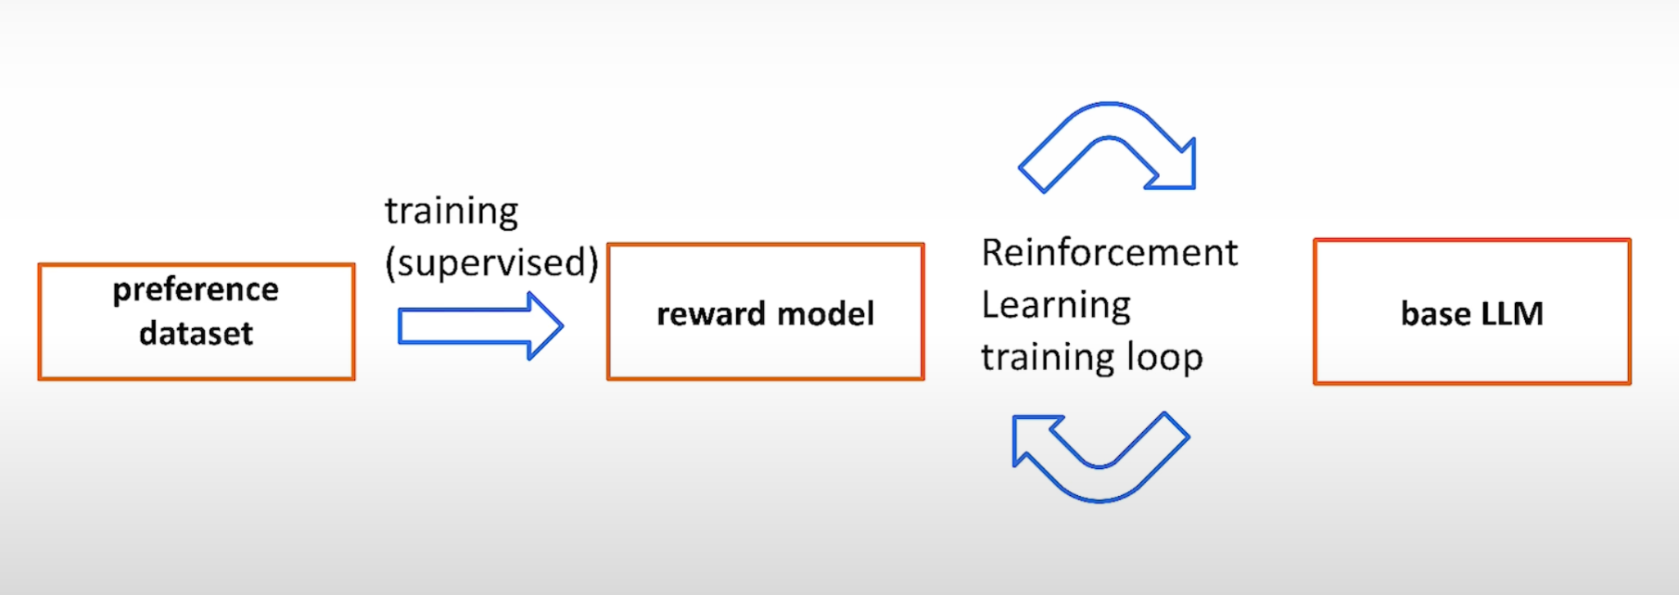

Slide 7
RLHF - Alignment
“Encode” the preferences into instructions for the human labelers
Alignment criteria
More funny
Less toxic
More positive

Slide 8
How was ChatGPT made?

Slide 9
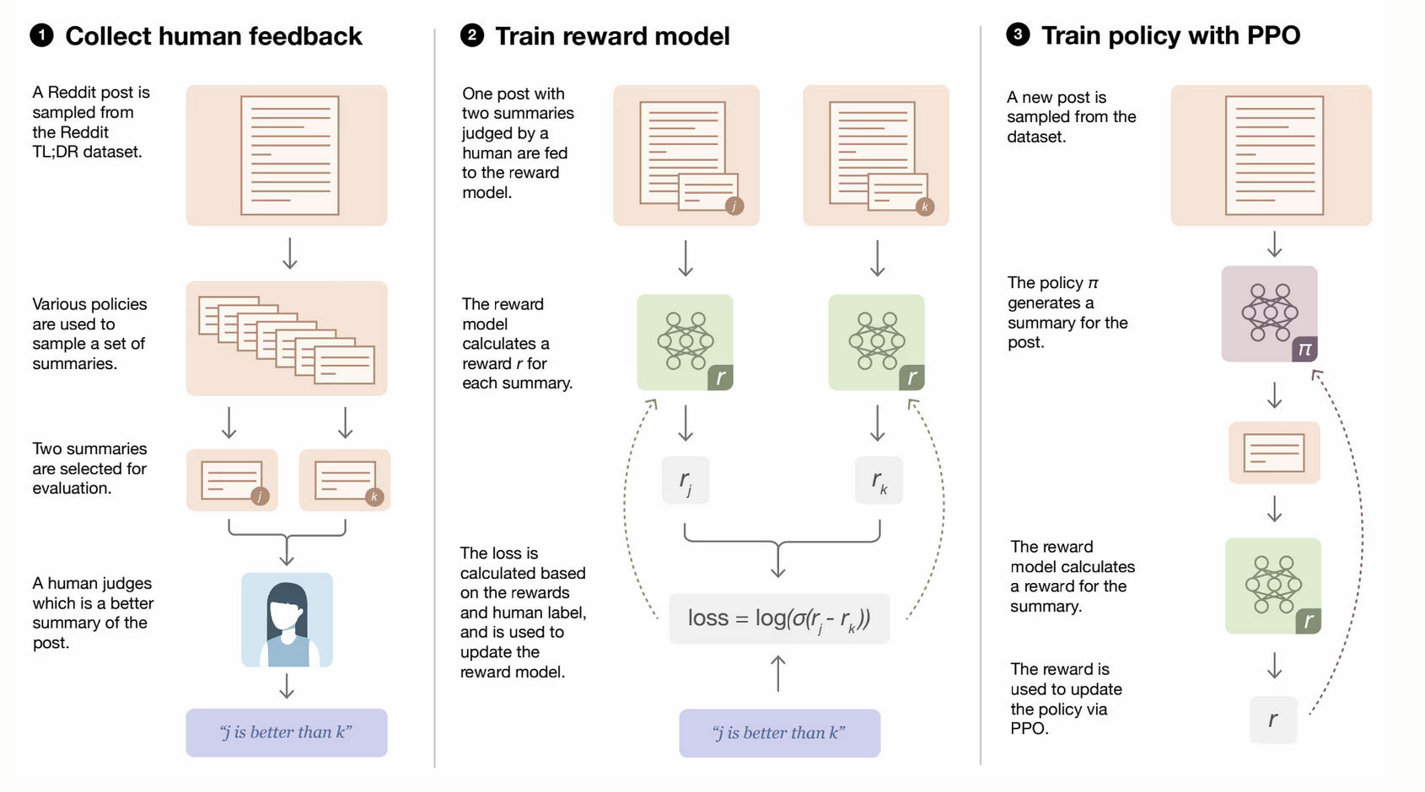

Slide 10
How was ChatGPT made?
Step0 (pretrained LLM):
Dataset: text corpus (collect the “internet”)
Learning: Self-supervised
Goal: predict next best word (token)
Step1 (Instruct/Chat LLM):
Dataset: Instructions+Responses/Conversations (user+assistant)
Learning: supervised fine-tuning
Goal: follow instruction / conduct conversation

Slide 11
How was ChatGPT made?
Step2 (reward model):
Dataset: comparisons/ranked possible responses
Learning: supervised learning
Goal: reward model calibrated with human preference, give score to responses (scalar value)
Step3 (RLHF):
Dataset: prompts
Learning: Policy gradient method - optimize policy (LLM) using reward model
Goal: more aligned language model to human preferences

Slide 12
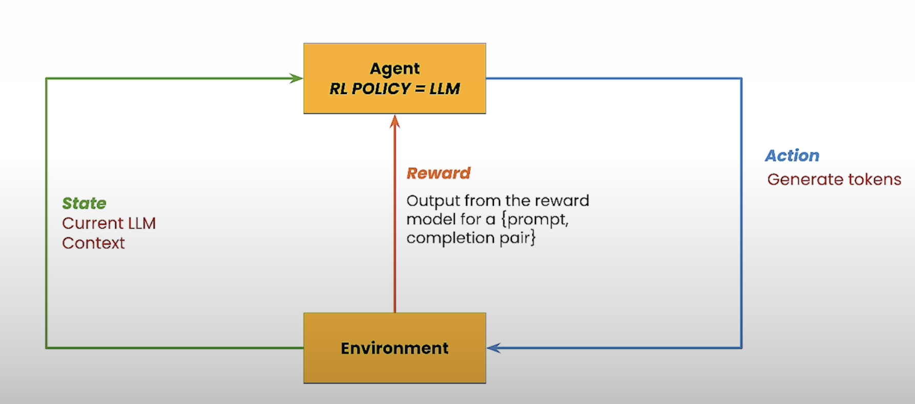

Slide 13
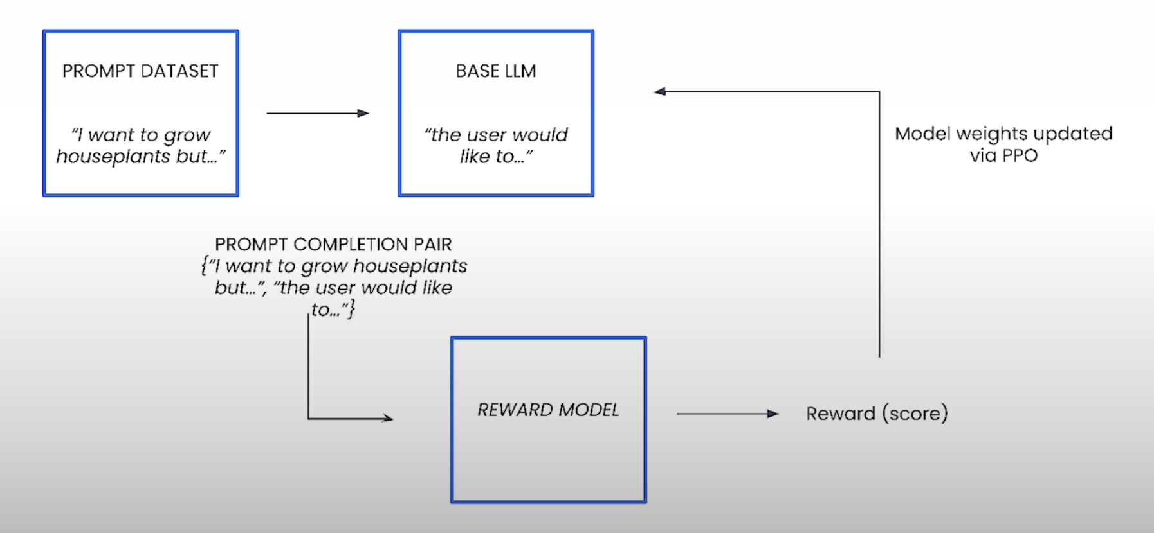

Slide 14
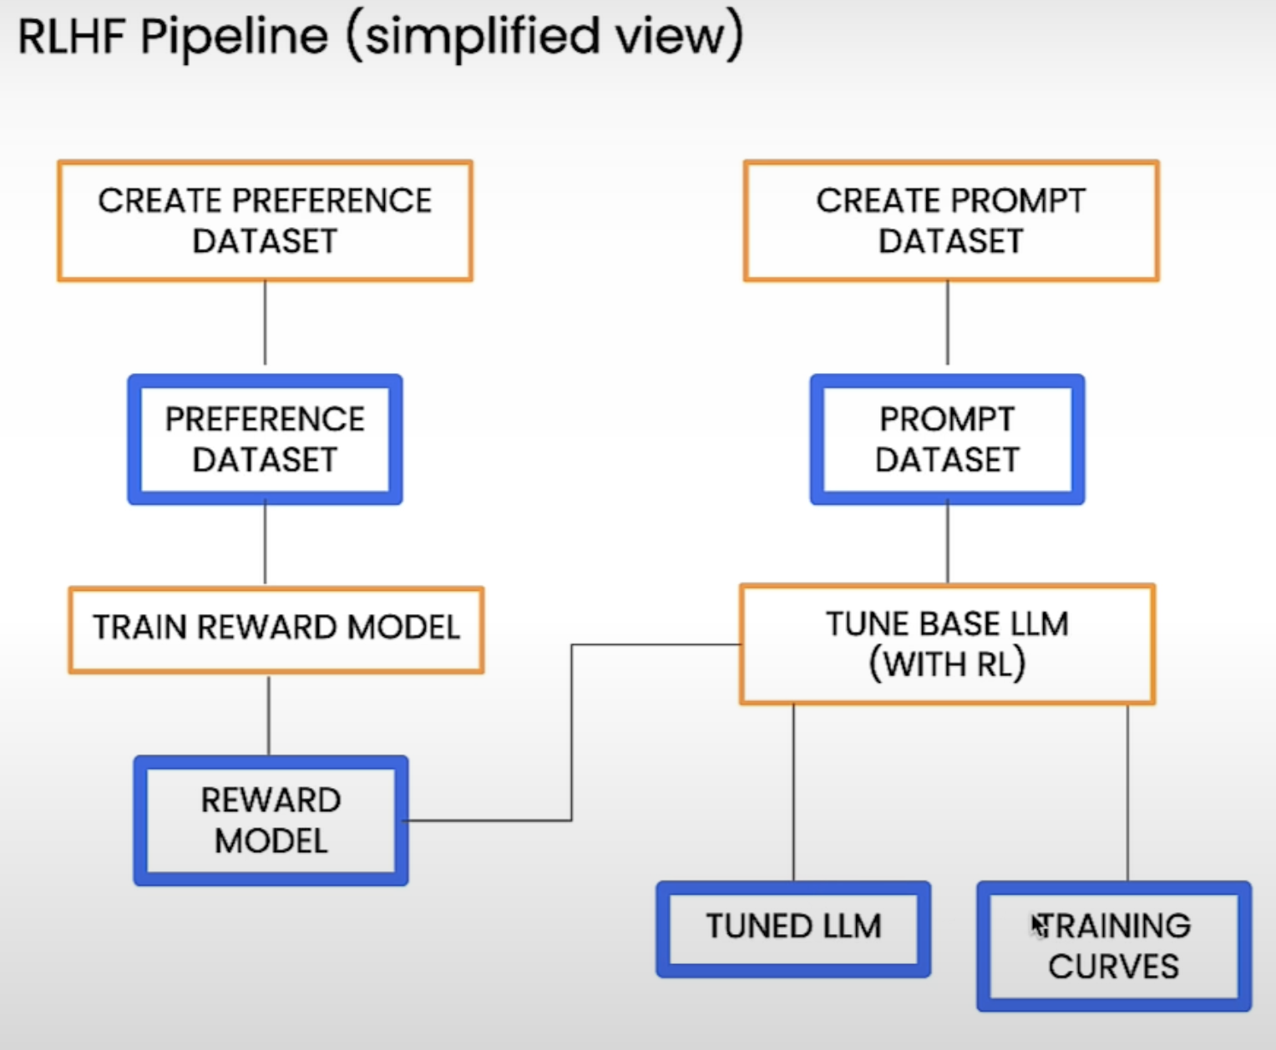

Slide 15
RL framework

Slide 16
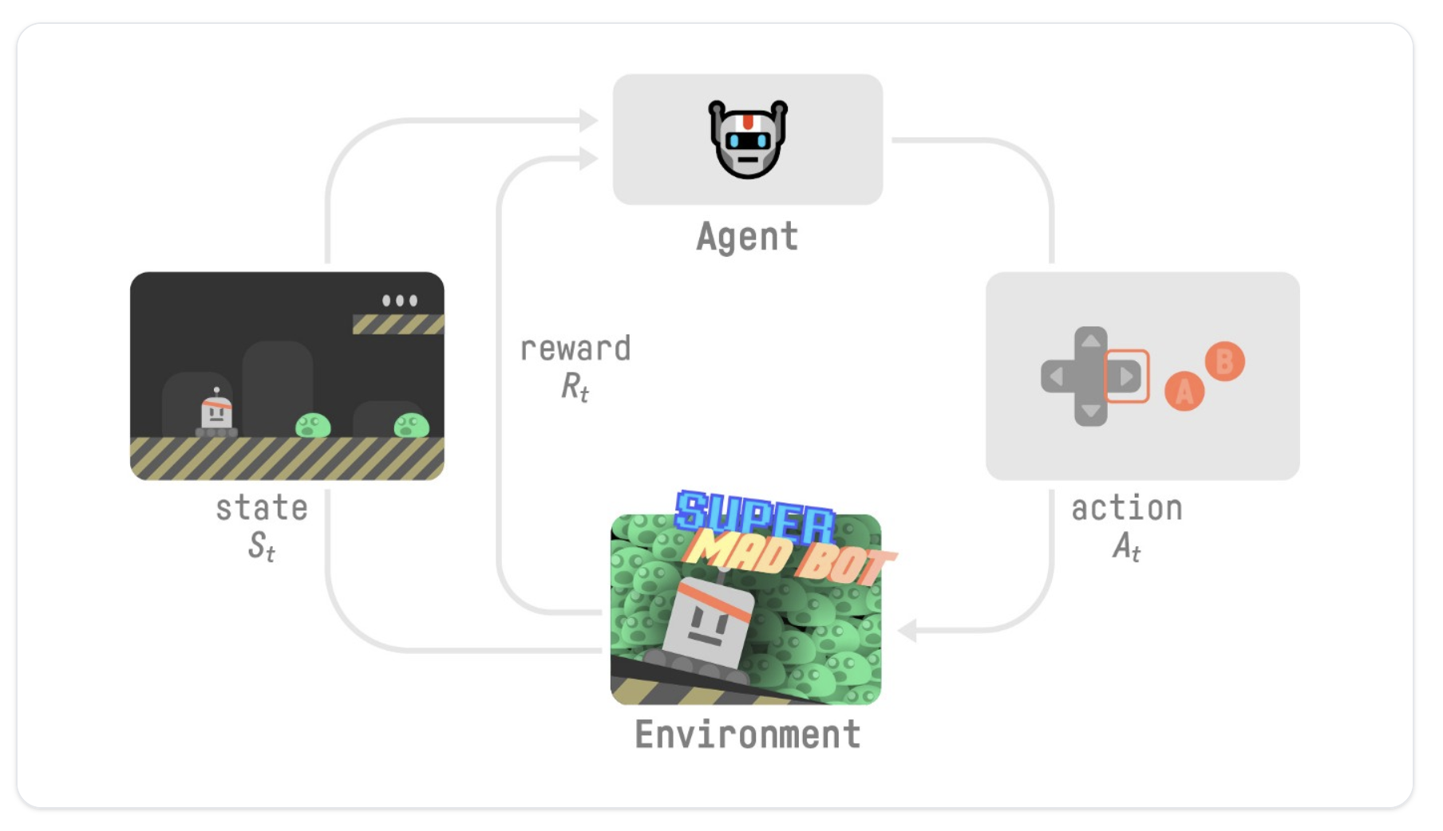

Slide 17
Exploration vs Exploitation Dilemma
Make a choice:
Take best decision given current information
Greedy, immediate reward, short-term optimum
Explore, look for new information
long-term rewards, but short-term losses

Slide 18
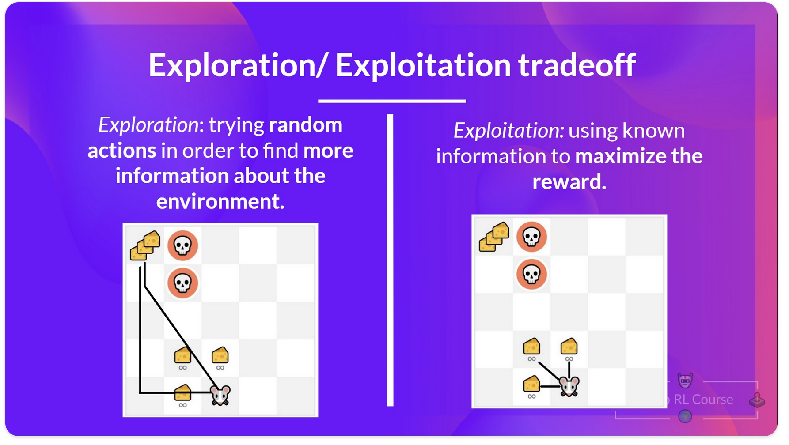

Slide 19
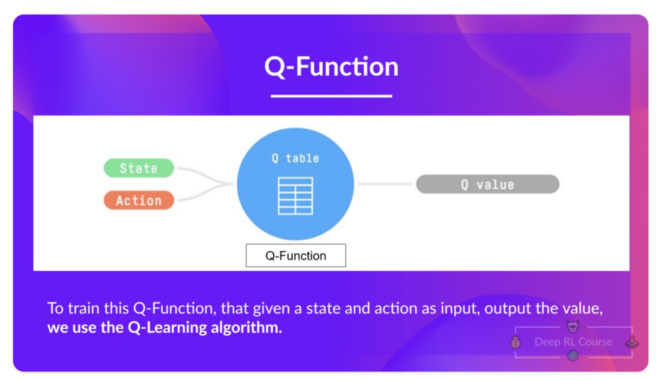
Q Learning

Slide 20
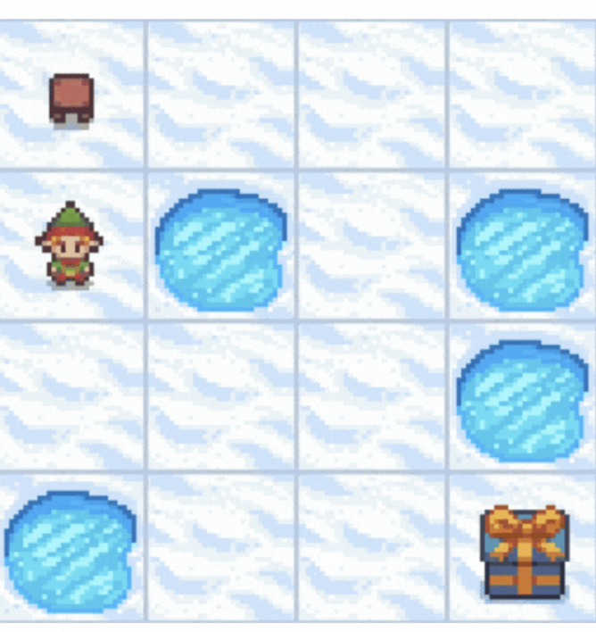
Hands-on

Slide 21
References
https://learn.deeplearning.ai/courses/reinforcement-learning-from-human-feedback
https://huggingface.co/blog/rlhf

